Slide 1


Music Critics
on the roles and functions
of music criticism
Elena Alessandri, Antonio Baldassarre, Victoria Williamson
Lucerne University of Applied Sciences and Arts, Switzerland
University of Sheffield, UK

Slide 2
INTRODUCTION
“Goode’s greater temperamental reserve gives his versions of these pieces an appealing refinement”
“Pre-echo spoils the silence twelve bars after the change to four flats in the first movement”
“I could wish that the recording companies would turn their attention to some of the lesser recorded sonatas”

Slide 3
INTRODUCTION
Music Performance Criticism
Common form of written response
Description, analysis, categorization, evaluation
Focus on how the music work is performed
Relevant to consumers and musicians

Slide 4
INTRODUCTION
The Review Product:
What critics write about
Aspects of performance discussed
Criteria used to evaluate performance
Alessandri, Williamson, et al. (2016). A critical ear: Analysis of value judgements in reviews of Beethoven’s piano sonata recordings. Frontiers in Psychology, 7:391
Alessandri, Williamson, et al. (2015). Beethoven recordings reviewed: a systematic method for mapping the content of music performance criticism. Frontiers in Psychology, 6:57
Alessandri (2014). The notion of expression in music criticism. In Fabian, Timmers & Schubert (Eds.), Expressiveness in music performance: Empirical approaches across styles and cultures. Oxford: Oxford University Press, 22-33
Alessandri, Eiholzer, Williamon (2014). Reviewing critical practice: An analysis of Gramophone’s reviews of Beethoven’s piano sonatas, 1923-2010. Musicae Scientiae, 18, 131-149

Slide 5
INTRODUCTION
The Review Product:
What critics write about
The Process of Reviewing:
Critics’ intentions and believes
Critics’ View on
The Role and Impact of Music Criticism

Slide 6
INTRODUCTION
The Critic View

Slide 7
METHOD
The Critics
8 English / 6 German speaking
Age 32 – 76; 2 women / 12 men
32 year professional activity (40 reviews in a year)
BBC Music, Gramophone, Fono Forum, Rondo, etc.
Rich, varied experience
Active performers, editors, record producers
High Musical Sophistication Index (GoldMSI)
Critics’ average 102.79 vs. population 81.58

Slide 8
METHOD
The Interviews
Summer 2016
UK, Germany, Switzerland
In-depth
Average length 1hr 42’ (range 1hr 12’ – 2hrs 57’)
Semi-structured
Review content
Use of language, style, rhetoric
Role of professional criticism

Slide 9
METHOD
The Analysis
Double-coder Inductive Thematic Analysis
I – Model Development (English Interviews)
Two researchers – open coding
Theme comparison and discussion
Two researchers – re-coding of whole text (Cohen’s Kappa 0.985)
II – Model Application (German Interviews)
Two researchers – code application (Cohen’s Kappa 0.897)

Slide 10
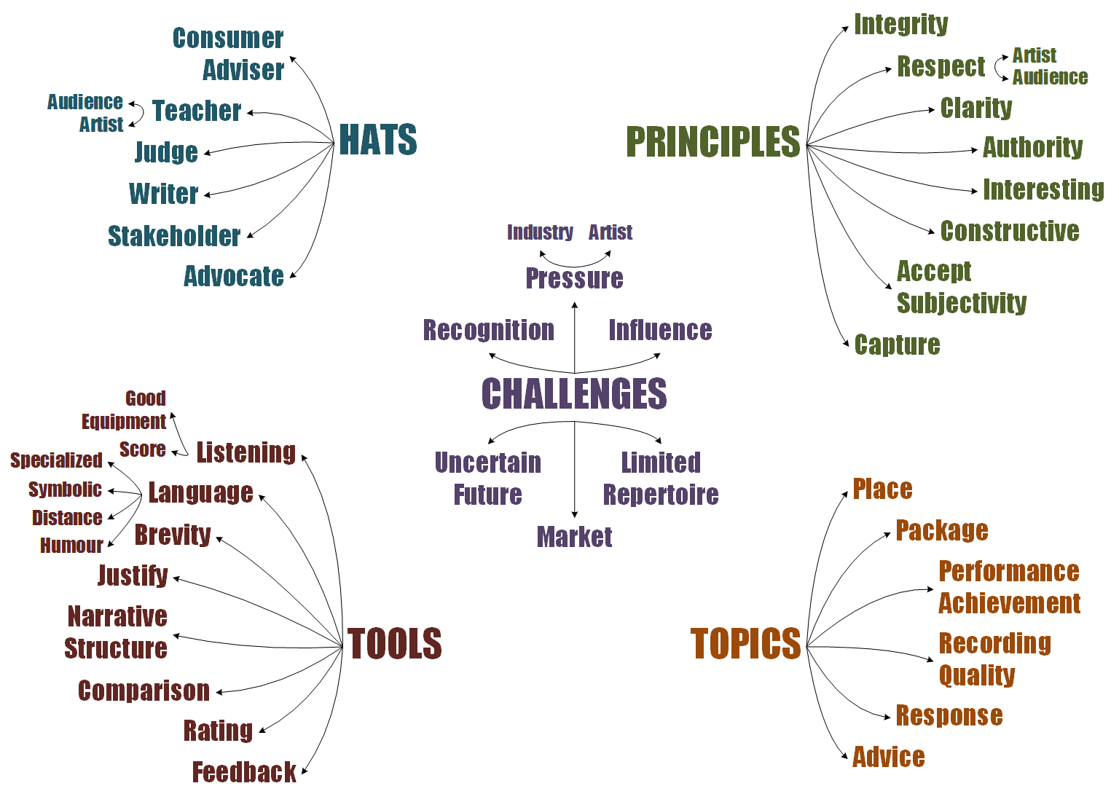
FINDINGS

Slide 11
FINDINGS
Things I am.
“I’m concerned about guiding people to the product.”
“Without reviews the market would only half-function, because it needs to have the critical input, the validation from Critics”
“The role today of professional criticism?
Well, it is that conduit from the producer to the public. It is that bridge.”
“…the power of the press is considerable, in terms of the effect it can have on the career of musicians. I think that’s the sort of thing I’m very, very aware of. I feel I’m doing it for the musicians. I’m writing for them.”

Slide 12
FINDINGS
Things I must be or have.
Things I am.
“Have I said it in the simplest way, the clearest way possible? Have I used a long word where I can use a short word? That’s not to say that you can’t use complex language, you can, but it has to be immediately understandable and immediately clear to the reader.”
“…there is an element of courage in reviewing.
It sounds rather grand, but you have to be prepared to say what you believe and what you think.”
“…that’s important, that the Critic understands what the Artist is going through”

Slide 13
FINDINGS
Things I feel about my job.

Slide 14
FINDINGS
“…you have to always be thinking about the legal consequences, you don’t want to libel anyone …you have to be quite careful with your language to make sure that you don’t say anything that they could take you to court over.”
“The danger for Critics is to get too close to people in the business, so close you can’t be truthful.”
“I’m well aware that a very, very, very unkind review can damage people emotionally.”
“…the freeness of the internet is a great boon in some ways, but it’s a disaster in others, because it’s overload, information overload is what we have. And, you know, it’s very difficult to weed out what opinions are worth reading, for readers.”
“I don’t know how people are going to consume music. The question is if you’ve got YouTube and you’ve got iTunes and, you know, all these massive channels for acquiring music, how do you guide people and do people want to be guided?”
“…if you don’t take that Editor’s advice, you might find yourself out of work.”
“…we’re in a world now where that bridge, between the producer and the consumer, is now being staffed by people who are doing it as volunteers really. It’s a free world. The paid Critics are becoming fewer and further between.”
“I know that labels are liable to use my words to advertise the Pianist. So, I’m aware of the power and the power of the press.”
Things I feel about my job.

Slide 15
FINDINGS
Things I discuss.

Slide 16
FINDINGS
“It is a story. You have to be able to shape some kind of thread and narrative through it.”
“Begin with a fanfare. So get the reader’s attention. And end with a cadence, so you get the feeling at the end that, yes, this is the end of the review.
We have come to a conclusion.”
“It’s interesting, I think, the use of whether you put yourself into the review or not. Whether you use “I”. …if you use it in the right way, I think it can be quite a powerful thing.
“…it’s part of the information that you need to give, as to why you come to a particular conclusion about a disc. And I think that’s, perhaps, what the essence of all of this is about. Because you have to, I think, you have to justify and make clear your process of thinking.”
Things I use when writing.
Things I discuss.

Slide 17
TO CONCLUDE…

Slide 18
TAKE AWAY POINTS
Critics as mediators between producers, artists, and consumers.
Multiple challenges: Changing role of criticism.
Critics as a valuable source of expertise and reflected practice.

Slide 19
WHAT NEXT?
The Review Product:
What critics write about
The Process of Reviewing:
Critics’ intentions and believes
The Consumer Voice:
Listeners’ expectations on criticism

Slide 20
WHAT NEXT?
The Review Product:
What critics write about
The Process of Reviewing:
Critics’ intentions and believes
The Consumer Voice:
Listeners’ expectations on criticism
Review Impact
www.hslu.ch/reviewimpact
The Consumer Voice:
Listeners’ expectations on criticism
Thank you!

